Slide 1
Article One Legislative Branch

Slide 2
House vs. Senate
435 Representatives
Based on population-More people more reps
Elected directly by the people
Each state must have at least one representative
100 Senators
2 For every state
Originally elected by state legislatures,
17th Amendment changed this to directly by people

Slide 3
House vs. Senate
Term of office 2 yrs. unlimited
25 yrs. Old minimum
US citizen 7 yrs.
Must be a resident of the state you represent
Title of the leader is
Speaker of the House-
Nancy Pelosi
Term of office 6 yrs. unlimited
30 yrs. Old minimum
US Citizen 9 yrs.
Must be a resident of the state you represent
Title of the leader is
President of the Senate
Vice Pres. Of US.
President Pro Tempore

Slide 7
NY’s US Senators

Slide 8
House
Every 10 yrs. a Census-population count is taken nation wide.
The Census is used to make any adjustments in the amount of rep.’s a state has.
States can lose/gain/stay same
This is known as Reapportionment/Redistricting
Each state is split into
Congressional Districts
Each district has its own representative.
The number of districts a state has depends on how many representatives it has.
NY 29 Districts=29 Reps
19th District John Hall

Slide 10
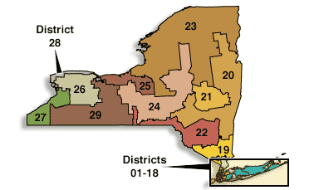

Slide 13
House vs. Senate
Selects President if no candidate wins majority of electoral votes
Impeaches elected official-formally charges w/crime
Begins all revenue bills
Earn Salary $170,000 yr.
Selects vice president
Acts as jury in impeachment trial
Approves all presidential treaties and presidential supreme court choices
Earn Salary $170,000 yr.

Slide 14
Blue vs. Red States

